Slide 1
Annual Interagency Accessibility Forum
Unlocking the Power of Accessibility
October 11-13, 2022
The UniDescription Project
Audio Describing the World, One Brochure at a Time

Slide 2
Session Panelists
Michele Hartley: Media Accessibility Coordinator, Harpers Ferry Center, NPS
Dr. Brett Oppegaard: Associate Professor, University of Hawaii, School of Communication and Information
Pat Sheehan, Chief: Section 508 Office, Section 508 Program Manager, U.S. Department of Veterans Affairs

Slide 3
Session Goals
Introduce UniDescription
Demonstrate the UniD platform and its resources
Learn about the iterative, collaborative approach
Format: Presentation, Demo, Conversation, Q&A

Slide 4
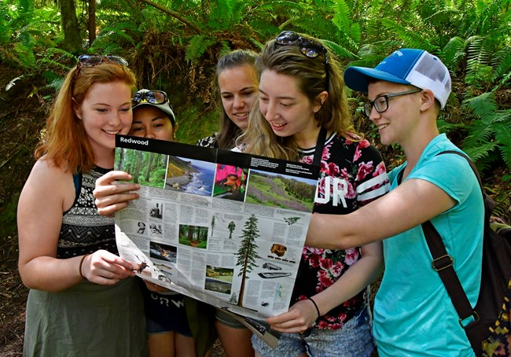
UniDescription (aka UniD) Project Goals
Audio describe NPS park brochures (Other organizations and static media included too)
Conduct and apply research to ensure effective communication

Slide 5
UniD Details
Partnership project
Primarily NPS/UH, ACB and others
Approach: Research, collaborate, work, learn, do, play
Grant funded and volunteer supported
NPS, Google, NEH, NEA (In-kind: NPS/UH)
Project start: 2014
165 brochures audio described to date

Slide 6
The Three Parts of UniD
Information
Development
Content Delivery
Collect/Disseminate
Research
Resources
Asynchronous Learning
Tools/Training/Writing
Editing Software
Hackathon-Style Workshopping
Descriptathon platform
Mobile app
UniD Website
Organizations’ websites

Slide 7
Let’s Tour and Talk! www.unidescription.org

Slide 8
Questions and Feedback

